Slide 1
Tenured Faculty Transition Policy

Slide 2
Overview
Provides options for tenured faculty members to transition to retirement.
Replaces past University policy and precedent with new permanent framework.
Two options: Tenure Buyout and Phased Retirement.
Effective January 1, 2019.
Policy and FAQ document available via Faculty tab of DrexelOne.

Slide 3
Tenure Buyout
Single sum, cash payment in exchange for relinquishing tenure.
65% of annual salary at least 10 but less than 20 years of service
100% of annual salary at least 20 but less than 30 years of service
110% of annual salary 30 or more years of service
Percentage amount refers to regular, annual salary.

Slide 4
Tenure Buyout: Eligibility Criteria
Full time tenured employee
Not participate in Phased Retirement
Minimum age 66
Minimum of 10 years of service
Meet Rule of 80
All eligibility criteria must be met on or prior to a tenured faculty member’s Tenure Relinquishment Date

Slide 5
Tenure Buyout: “Rule of 80” Example
A tenured faculty member who is age 66 and has 10 years of service would not yet meet "the Rule of 80" (66 + 10 = 76 < 80).
A tenured faculty member who is age 66 and has 15 years of service would meet the "Rule of 80" (66 + 15 = 81 > 80).

Slide 6
Tenure Buyout: Standard Election Time Periods (Example of First Meeting Eligibility Criteria on August 21, 2022)
SAMPLE TENURE BUYOUT / TENURE RELINQUISHMENT TIMELINE
Sample Eligibility Start Date | Sample Dates to Receive Tenure Buyout / Tenure Relinquishment Date
August 21, 2022 | August 31, 2022
 | August 31, 2023
 | August 31, 2024
 | August 31, 2025
 | August 31, 2026
 | No longer eligible

Slide 7
Tenure Buyout: Election Form
Submit Election and General Release of Claims Form to Office of Faculty Advancement between May 1 and August 31 of academic year prior to tenure relinquishment
Example: You must submit the Election and General Release of Claims form by August 31, 2023 for an
August 31, 2024 tenure relinquishment
Form is available on the Faculty tab of DrexelOne.

Slide 8
Phased Retirement
Reduce work schedule and commensurate pay for up to three consecutive academic years.
Relinquish tenure and retire at the end of the phased retirement period.

Slide 9
Phased Retirement Options
One-Year Phased Retirement Period: Choose 25% or 50% reduction in work and pay for one academic year.
Two-Year Phased Retirement Period: Choose 25% or 50% reduction in work and pay for each of two consecutive, academic years or choose 25% reduction in work and pay for the first academic year and a 50% reduction in work and pay for the second, consecutive academic year.
Three-Year Phased Retirement Period: 25% reduction in work and pay for the first academic year, 50% reduction in the second consecutive, academic year and 75% reduction in the third consecutive, academic year.

Slide 10
Phased Retirement: Eligibility Criteria
Regular, full-time tenured faculty member
Minimum age 62
Minimum of 10 years of service
Must not have elected to participate in the Tenure Buyout
All eligibility criteria must be met on or prior to a tenured faculty member’s Phased Retirement Date

Slide 11
Phased Retirement: Participation Process
Communicate decision to Department Head no later than December 31st of the academic year prior to the academic year in which Phased Retirement period will begin.
Submit Phased Retirement Election Form signed by (1) faculty member participating in the Phased Retirement; (2) your department chair; (3) your dean; and (4) the Senior Vice Provost for Faculty Affairs.

Slide 12
Phased Retirement: Election Form
Submit Election Form to Office of Faculty Advancement no later than March 1 (or closest preceding business day) of the academic year prior to the academic year in which you plan to begin your Phased Retirement period.
Form is available on the Faculty tab of DrexelOne.

Slide 13
Retiree Health Benefits
Who can I cover?
Retiree
Spouse or Domestic Partner of record at the time of retirement
Spouses or Domestic Partners established after retirement are not eligible
**Children are not eligible for coverage under the retiree plan. COBRA is offered when active health benefits terminate.

Slide 14
Retiree Health Benefits
Under age 65 - Medical/Rx Plans
Those who are not eligible for Medicare have access to the same medical/prescription plans that are offered to the active employee population.
At the time of retirement, if choosing to enroll, you would continue in your current plan with the option of changing plans at the next annual enrollment period.

Slide 15
Retiree Health Benefits
Age 65+ (Medicare Eligible) Medical/Rx Plan
Personal Choice 65 PPO
offered to Medicare eligible retirees and spouses/domestic partners It offers benefits beyond Original Medicare and includes benefits only available to Blue Cross Medicare Advantage plan members.
Must be entitled and enrolled in both Medicare Parts A and B.
Personal Choice 65 PPO Rx plan provides an integrated prescription drug benefit
Medicare Part D coverage that follows their formulary rules
Vision included
Notes:
The Independence Blue Cross Personal Choice 65 (PPO), is a Medicare Advantage preferred provider organization plan (PPO) that is offered for Retirees and their Spouses or Domestic Partners of record who are eligible for Medicare. It offers benefits beyond Original Medicare and includes benefits only available to Blue Cross Medicare Advantage plan members.
To qualify, you must be entitled and enrolled in both Medicare Parts A and B. You are responsible for payment of the ongoing Medicare Part B premium, along with your Personal Choice 65 PPO premiums that are paid to WEX on a monthly basis.
The Independence Blue Cross Rx plan provides the prescription drug benefits integrated into your Medicare Advantage plan. It provides Medicare Part D coverage and follows their rules.
Biennial Vision Benefit is built into this plan.

Slide 16
Retiree Health Benefits
Dental
Drexel University offers retirees the same dental coverage that active employees have. Currently there are three dental options through Cigna:
Cigna Basic PPO
Cigna Preferred PPO
Cigna DHMO
Vision
Drexel University offers retirees the same vision coverage that active employees have. Drexel's vision plan is offered through Davis Vision, administered through Independence Blue Cross.
Notes:
Dental and Vision plans are stand alone options and do not need to be enrolled in. Retirees can waive these benefits if they chose and reelect during annual enrollment during the fall for January 1.
Both plans are the same plans offered to active employees.

Slide 17
403(b) and 457(b) Retirement Plan
403(b) Defined Contribution Retirement Plan
When you leave the University, you have several options for your 403(b) account. You can keep your funds in the Drexel plan, rollover your account to an eligible retirement plan or IRA, or take a distribution. You are required to start taking certain withdrawals from your account when you reach age 73. Please contact TIAA to discuss what’s right for you.
For general questions, contact TIAA participant services at 800.842.2252. To schedule an individual consultation with a TIAA financial consultant visit TIAA.org/schedulenow-drexel or call 800.732.8353.
457(b) Deferred Compensation Plan
Within 60 days of your separation from employment, you must elect to take a distribution from your 457(b) account or postpone distribution to a later date. TIAA will send you an election packet in the mail. If you do not make an election within 60 days, your account will be automatically paid to you as a single lump-sum payment.
Schedule a consultation with TIAA Financial Consultant for the 457(b) plan, Sabrina Evenosky, by calling 267-675-8161 or sign up for an appointment online at TIAA.org/schedulenow-drexel

Slide 18
Other Benefits
Tuition Remission
SupportLinc
Health Advocate
Courtesy Retiree ID Card
Email
Recreation Center membership offers
Annual Retiree Luncheon
Dragon Perks Voluntary Benefits
Notes:
Tuition Remission – available for retiree, spouse and dependent children at level the retiree was entitled on date of retirement.
Courtesy Retiree ID Card
Recreation Center memberships
Annual Retiree Luncheon
If you are a current participant with any of our voluntary benefits, such as Liberty Mutual Home and Auto Insurance, Genworth Long Term Care and Allstate Critical Illness, your benefits can continue. Payments for coverage would transition from payroll deductions to direct bill with the individual vendor.

Slide 19
Things to Consider
3 months prior to your date of retirement review the information on https://drexel.edu/hr/benefits/retirement/retiree-benefits/
Meet with an HR Benefits Consultant if you are planning to enroll in the Drexel Retiree Health Plan.
You should advise your department of your intent to participate in the TFTP so that they can take appropriate action to transition your position
Your supervisor or department head should meet with you before your last day to discuss the employee separation checklist.
Notes:
3 months prior to your date of retirement review the information on https://drexel.edu/hr/benefits/retirement/retiree-benefits/
Any changes to the policy and process will be listed here, if applicable.
Meet with an HR Benefits Consultant if you are planning to enroll in the Drexel Retiree Health Plan.
You should advise your department of your intent to participate in TFTP so that they can take appropriate action to transition your position. This involves submitting an EPAF to HRIS so that your record can updated in Banner and Benefits can work with the administrator, WEX, on your transition off of the active employee benefits and into the Drexel retirement plan (if applicable).
Your supervisor or department head should meet with you before your last day to discuss the employee separation checklist.
You will have an opportunity to provide feedback to the University about your employment experience by requesting an exit interview with a HR Business Partner.

Slide 20
Things to Consider
If you or your spouse/partner are age 65 or older:
Make an appointment with your local Social Security Office to sign up for Medicare Parts A and B, if you have previously waived Part B.
The typical timeline that Social Security requires for processing enrollments for Part B is 60-90 days before you want the benefit effective.
Drexel will provide confirmation of enrollment in health/prescription insurance for those who are Medicare Eligible and are being covered under our ‘Active’ employee benefits. This document will be included in your retirement benefits package.
Please connect with Human Resources prior to your Social Security appointment to ensure you have this document.
Notes:
If you or your spouse/partner are age 65 or older:
Make an appointment with your local Social Security Office to sign up for Medicare Parts A and B, if you have previously waived Part B. The typical timeline that Social Security requires for processing enrollments for Part B is 60-90 days before you want the benefit effective. So, if your retirement date is 8/31, you will need Medicare Part B effective 9/1. You should be meeting with Social Security end of June, beginning of July at the latest. You can always meet with them before that but submission of your Part B application and supporting docs should be done by this timeline.
While you can submit your application online, there is the ability of doing this process in person at your local office to ensure that your application has been received and is in process. Typically the processing timeline for the applications is about 10-15 business days, then they provide you a letter confirming that your application has been received and approved. The ID card and more detail about your benefit will be sent later but if it has been a month and you haven’t heard anything from them about your app, be sure to reach out to them to make sure that nothing is missing.
Drexel will be required to provide confirmation of enrollment in health/prescription insurance for those who have waived Part B while still being covered under our ‘Active’ employee benefits. Please connect with Human Resources prior to your Social Security appointment to ensure you have this document.
www.socialsecurity.gov – apply for Social Security online
www.medicare.gov – apply for Medicare online

Slide 21
Things to Consider
The standard Medicare Part B premium amount in 2023 is $164.90. Most people pay the standard Part B premium amount; however, the premium is income based and is determined using your modified adjusted gross income as reported on your IRS tax return.
If you have a higher income, you will pay an additional Income Related Monthly Adjustment Amount (IRMAA). More information on premiums and IRMAA can be found on the Social Security website: https://www.ssa.gov/benefits/medicare/medicare-premiums.html#anchor1
Note that those who receive Tenure Buyout will have an inflated income in the year that they receive their payment. This may cause an increase in the premiums after that year’s taxes are filed, but you can discuss with Social Security how to go about appealing the monthly premium if that does occur.
Appeals to IRMAA can be made with Social Security directly, please visit the Medicare website for more information on this please visit their website: https://www.ssa.gov/medicare/lower-irmaa
Notes:
Note that you will have a monthly premium paid to Social Security for your Medicare Part B premium, along with your Drexel Health Insurance premiums that are paid to WEX on a monthly basis, should you choose to enroll in the Drexel plan.

Slide 22
Resources
SupporLinc: Retirement Coaches Connect with a live SupportLinc representative by calling their 24/7 helpline at 1.888.881.5462
https://www.supportlinc.com/
Health Advocate: Medicare Consultations: 866.695.8622
For more information on Medicare and the costs associated with it, please visit their website: https://www.medicare.gov/basics/costs/medicare-costs
More information on premiums and IRMAA can be found on the Social Security website: https://www.ssa.gov/benefits/medicare/medicare-premiums.html#anchor1
Appeals to IRMAA can be made with Social Security directly, please visit the Medicare website for more information on this please visit their website: https://www.ssa.gov/medicare/lower-irmaa
Apply for Medicare online: www.medicare.gov
Apply for Social Security online: www.socialsecurity.gov

Slide 23
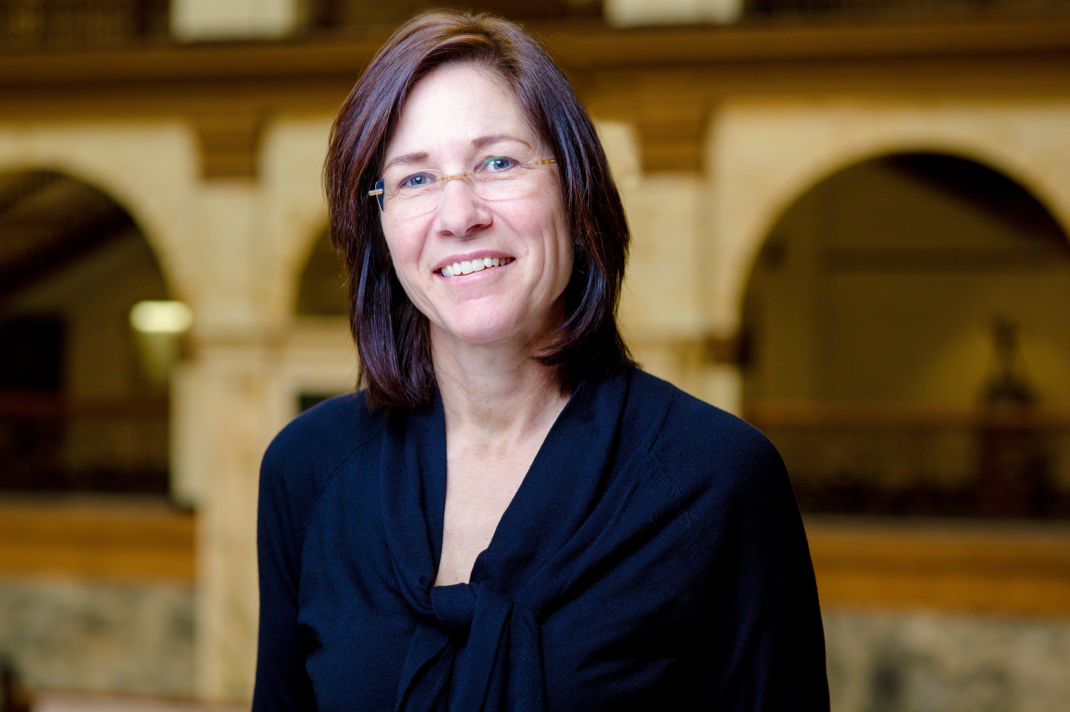
Questions?
Erin McNamara Horvat
Senior Vice Provost
Office of Faculty Advancement
emh@drexel.edu
215-895-1827
Remy Van Wyk
Manager, Faculty Lifecycle
Office of Faculty Advancement
rv434@drexel.edu
215-895-4903
Kristin Bellamy
Senior Benefits Consultant
Human Resources
kmm472@drexel.edu
215.895.4985
Danielle McClellan
Benefits Consultant
Human Resources
dm3689@drexel.edu
215.895.6131

